Slide 1
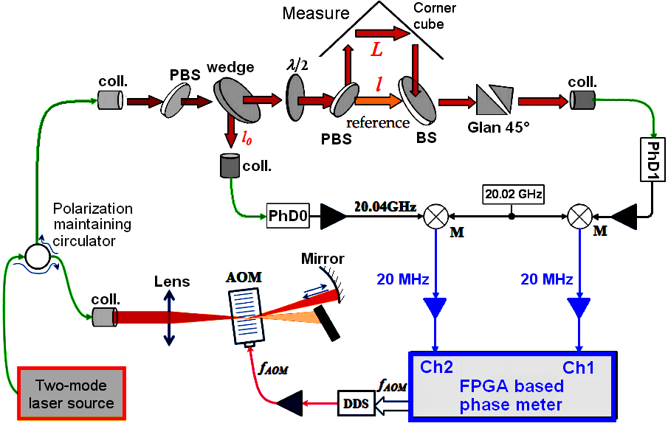
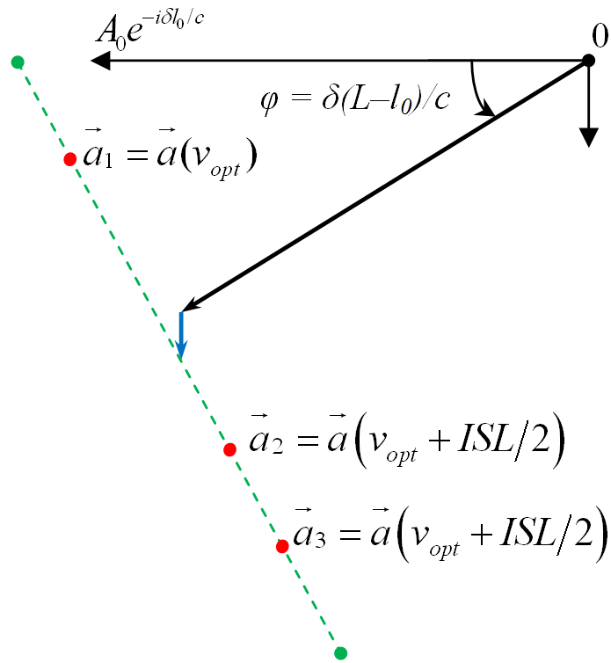
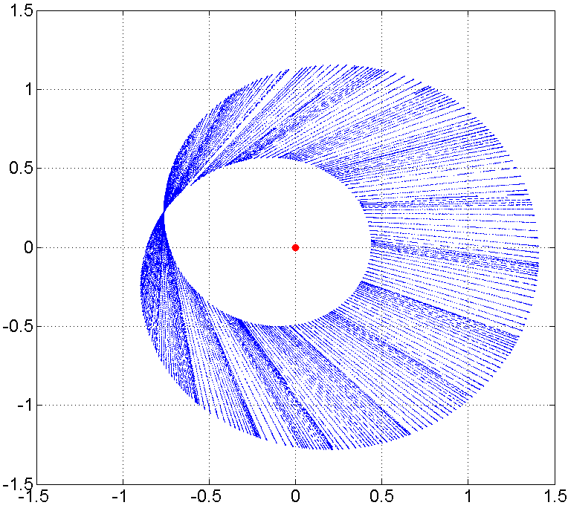
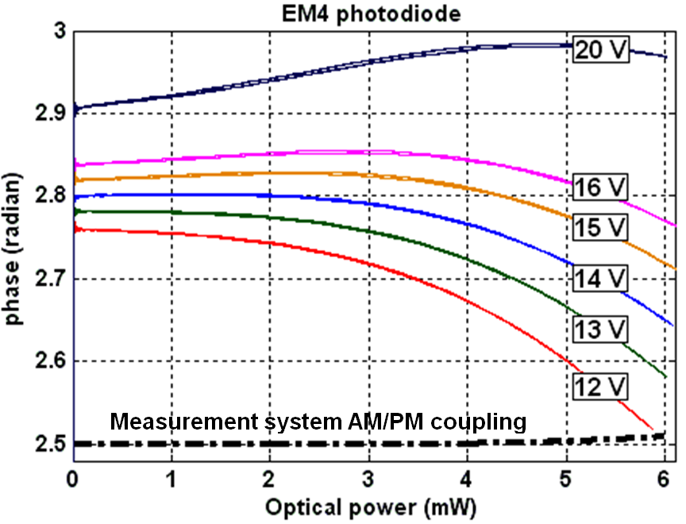
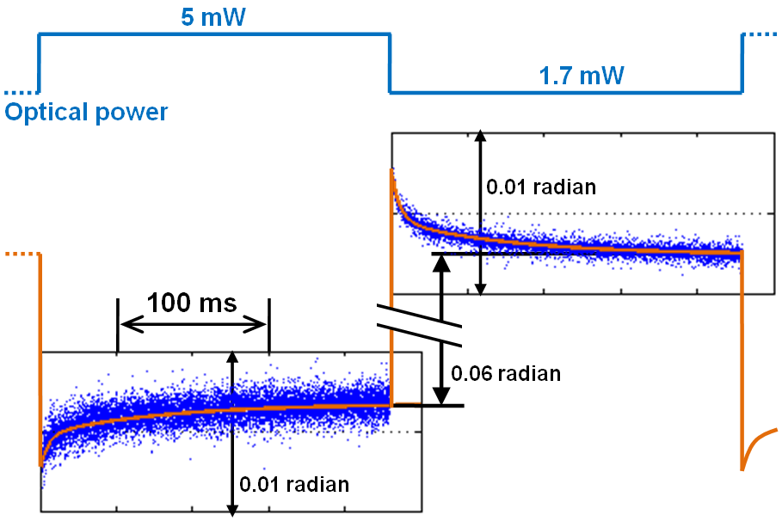
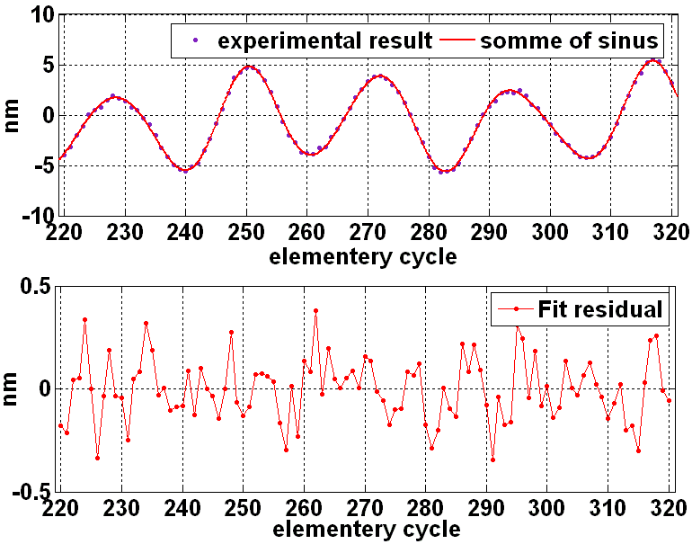
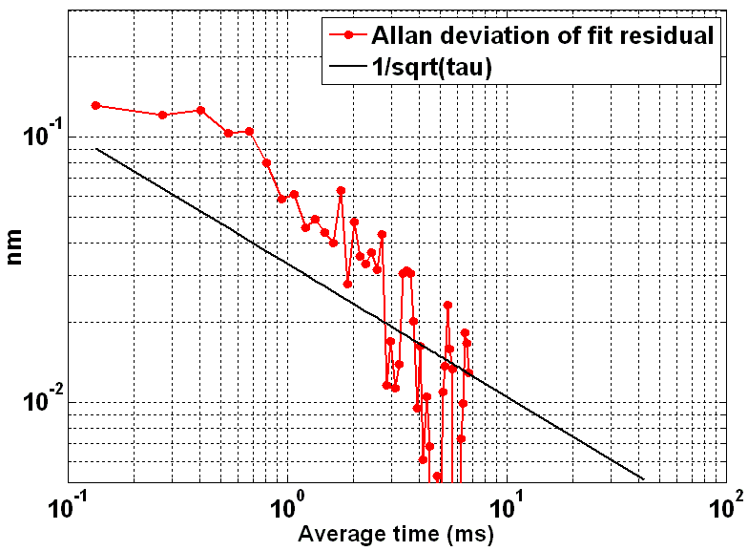
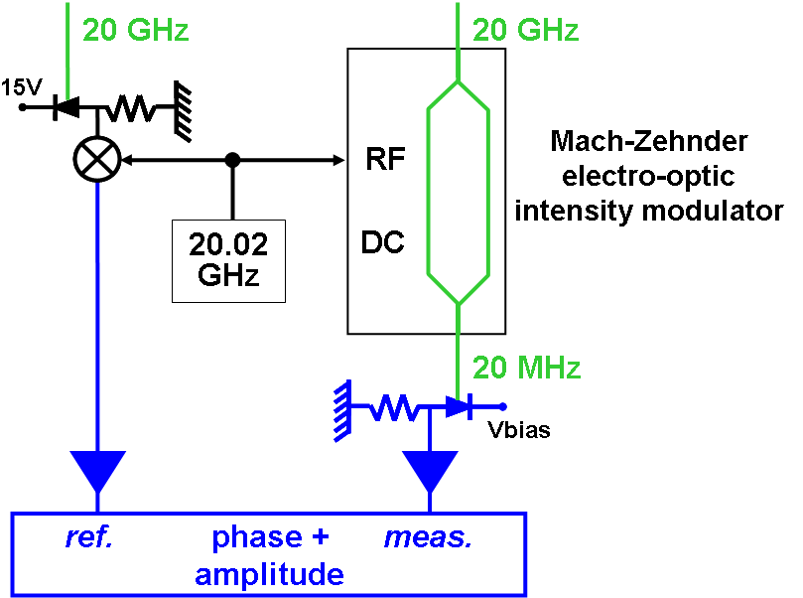
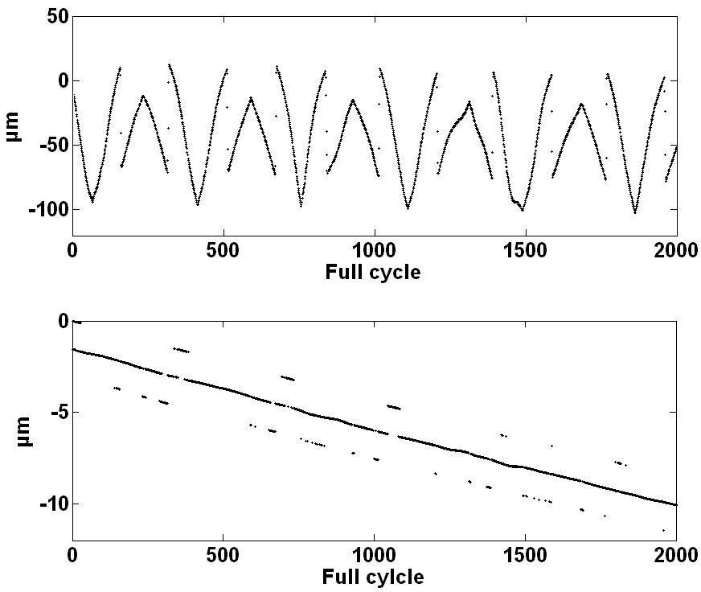
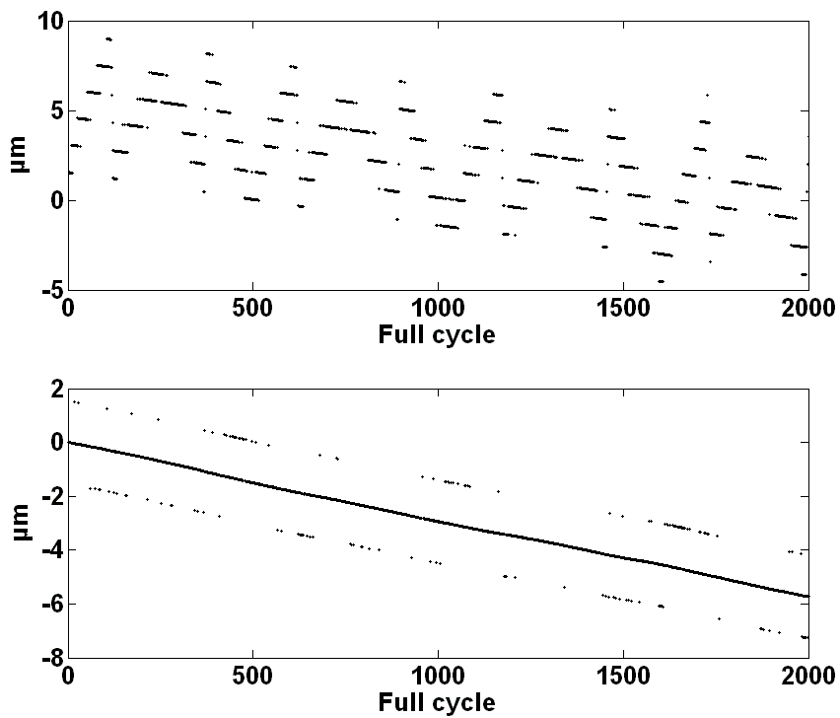
A two-mode range meter for nanometric accuracy (& picometric resolution) long distance measurements in space
D. H. Phung¹, C. Courde¹, A.Brillet¹, C.Alexandre², M. Lintz¹ (michel.lintz@oca.eu),
¹ARTEMIS, Observatoire de la Côte d'Azur, Nice, France
²Laboratoire CEDRIC-LAETITIA , CNAM, 292 rue Saint Martin, 75141 Paris, France
Iliade Collab. with Etienne Samain (GéoAzur, OCA) and Stéphane Pitois (ICB, Univ. Dijon)
Funding: ANR (grant ANR-07-BLAN-0309-01) and CNES
- A two-mode beam probes the reference and measurement paths
- Interference signal provides cm- and µm-scale measurements
- absolute distance information from time-of-flight measurements
- sub-nm precision expected. 0.3nm resolution over 135µs
Iliade
Experimental setup
_{Collimator}
_{Collimator}
Measurement principle
Two phase measurements of optical wavelength (1.55 microns) and the synthetic wavelength (15 mm) are extracted from the same two-mode interference signal to prevent systematic errors due to slow drifts in the micro wave components.
two-mode
beat
Measurement
arm
target
v_{opt} scan
FPGA
Phase and
amplitudes
4
Laser beams ; Optical fibre, HF (20 GHz) signals, IF (20 MHz) signals
(P)BS: (polarizing) beam splitter; AOM: Acousto-optic modulator; DDS: direct digital synthesizer. PhD: photodiodes M: mixers
One elementary measurement cycle (3 data points): 135 µs.
Full measurement cycle (320 elementary cycles) = 43ms
2πc/δ = Λ, "synthetic wavelength", 15 mm
2πc/ω = λ, optical wavelength, 1.55 µm
Experimental signals, L scan
Systematic errors
L scan
phase/amplitude diagram
Three different length scales
1. a time-of-flight measurement,
=> absolute ranging, precision <mm,
2. "synthetic wavelength" phase
(modulo Λ=c/20GHz=15mm)
3. optical wavelength phase
(modulo λ_{opt}=1.5µm=Λ/10⁴),
=> high resolution (0.3nm in 135µs)
10⁴ dents!
(F=20GHz,
λ_{opt}=1.5µm)
Electronic Cross-talk between detection channels (-60dB; 4 parameters)
easily corrected in the measured data
Amplitude-to-phase coupling in the 20 GHz photodiode
Stationary AM/PM coupling
Transient AM/PM coupling
1 cycle ~ 15 mm
Thermal effects
µs & ms time scales
Requirement: µ-wave measurement precision has to be better than 10⁻⁴ cycle and 10⁻⁴ !
Ranging measurement resolution
200 pm at 135 µs (expected 150 pm)
10 pm expected @ 43 ms
Length measurement, shifted by 7.492717 m
Allan deviation of measurement noise
easily corrected
difficult to correct!
acoustic perturbations
of the 7.5 m optical path
How to reduce AM/PM by 1000 ??
13.5 ms
Mixer replaced by an optical demodulator (before the photodiode) :
Systematic reduced by fact. 1000 (20GHz/20MHz)
Electrical cross-talk between the reference and measurement chains is lower (-80 dB)
The resolution measurement is better than 200 pm at 135 µs.
and better than 10 pm at 43 ms.
Measurement convergence , 2000 full cycle measurements,
conclusions
Complex signal...
...with strong signature,
helps identification of systematics
Accuracy not yet tested, (expected: nm)
but 200 pm resolution @ 150 µs,
improves as 1/√
Solution has been found to AM-to-PM
No femtosecond laser
Update rate 50 ms, possibly 150 µs
Phung et al Opt. Lett. 38(2013) p. 281
Phung et al, Meas. Sci. Technol. (submitted)
using electrical demodulation
(PhD detects 20 GHz modulation)
using optical demodulation
(PhD detects 20 MHz modulation)
Raw data:
large systematics
Raw data
100 s
100 s
τ
3 corrections: → cross-talk
→ stationary AM/PM
→ transient AM/PM
2 corrections: → cross-talk
→ stationary AM/PM
Convergence: 86 % (exp. 100%)
residual systematics
Convergence: 92 % (exp. 93.5%)

